Slide 1
RESUME PARSER WITH NLP
BY
ARULRAJ S (18MX203)
BALA RAJENDRA KUMAR R A (19MX151)
PROJECT GUIDE: Ms.K.GAYATHRI

Slide 2
PROBLEM STATEMENT
To design a model that can parse information from unstructured resumes and transform it to a structured JSON format.
Rank the extracted resumes and send to the company based on their job description.

Slide 3
ABSTRACT
Parse information from a resume using NLP
Find the keywords, cluster them onto sectors based on their keywords
Show the most relevant resume to the employer based on keyword matching
First, the user uploads a resume to the web platform
The parser parses all information from the resume and it is saved to NoSQL database
The user gets their resume in JSON format.

Slide 4
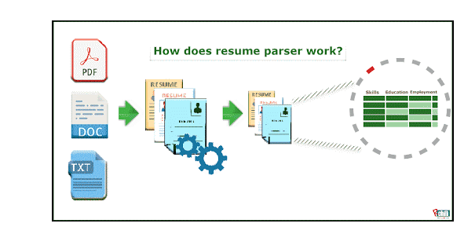

Slide 5
NATURAL LANGUAGE PROCESSING
I. Lexical Analysis
II. Syntactic Analysis
III. Semantic Analysis

Slide 6


